Slide 1
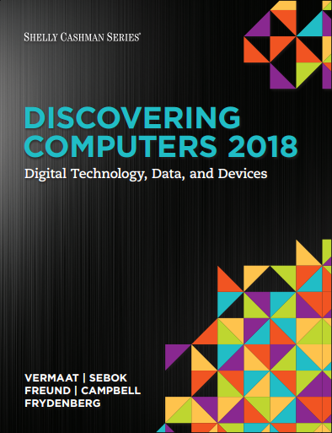

DISCOVERING COMPUTERS 2018 Digital Technology, Data, and Devices
Module 11
Building Solutions:
Database, System, and Application Development Tools
© 2018 Cengage版權所有，為課本著作之延伸教材，亦受著作權法之規範保護，僅作為授課教學使用，禁止列印、影印、未經授權重製和公開散佈

Slide 2
Objectives Overview
Databases, Data, and Information
File Processing Systems and Databases
Database Management Systems (DBMS)
System Development
Application Development Languages

Slide 3
Databases, Data, and Information (1 of 10)
Data
Collection of unprocessed items
Text
Numbers
Images
Audio
Video
Database
Collection of data organized in a manner that allows access, retrieval (檢索), and use of that data
Notes:
資料庫 - 以特定方式組織起來，可視為數位化的檔案櫃——儲存電子檔案的處所，方便存取、檢索和使用數據的集合
數據 – 還沒被處理過的東西
因為data是沒有被處理過的，所以database已有邏輯性的方式組織，方便使用

Slide 4
Databases, Data, and Information (2 of 10)
Information
Processed data
Organized
Meaningful
Useful
data
information
process
Notes:
Information-處理過的數據

Slide 5
Data/Information
Characteristic | Data | Information
Form | Raw, unprocessed form | Processed and organized to provide meaning
Value | Lacks inherent value | Has value to the user or context
Dependency | Independent of context | Depends on data for its creation
Context | No context, difficult to interpret | Provides context, easy to understand
Input/Output | Input for analysis or processing | Output after data is analyzed or processed
Example | The number 10, a date 2025/12/1, or a temperature 30°C. | Today's temperature is 30°C, which is warmer than yesterday.

Slide 6
https://youtube.com/shorts/x4s5Mpdd-Gw?si=326w9o9g7waOOGh3
https://youtube.com/shorts/qmqL4gtkJJs?si=Lhj8LQTlhntJDMIn

Slide 7
Databases, Data, and Information (4 of 10)
Database software, often called a database management system (DBMS), allows users to:
Create a computerized database
Add, modify, and delete data
Sort and retrieve data
Create forms and reports from the data
e.g. Microsoft SQL server, Oracle Database
Database像一個高冷傲嬌的公主，要接觸到他並不容易，
必須要經過一個僕人傳話，DBMS就像僕人
Notes:
DBMS-連接user跟database的窗口，是一種軟體
讓使用者可以創建database/修改/刪除/檢索data

Slide 8
Data is organized in levels
Characters, fields, records, and data files
A character (字元) is one byte
Numbers, letters, blank space, punctuation marks, or other symbols
A field (欄位) is a combination of one or more related characters
Field name
Field size
Data type
Figure 11-2 A sample school database with four data files: Student, Instructor, Schedule of Classes, and Student Schedule. The sample Instructor file contains four records. Each record contains six fields. The Instructor ID field can contain a maximum of six characters (bytes).
Source: Microsoft

Slide 9
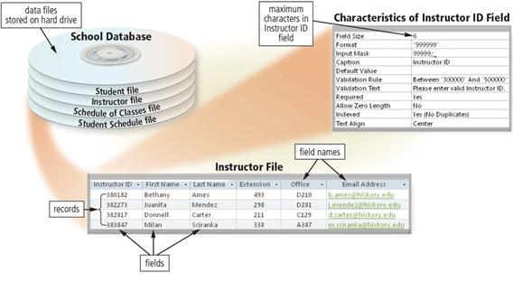
Databases, Data, and Information (6 of 10)
Notes:
以這張圖為例，我們可以看到一個database有許多的files，從中取出instructor file，直行的部分就是fields，橫列的部分就是records，一個record就紀錄了一個instructor的所有field data

Slide 10
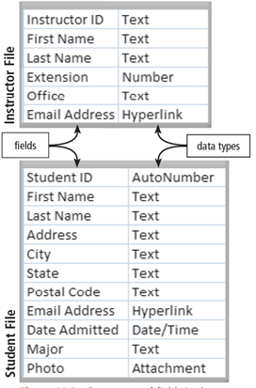
Figure 11-3 Data types of fields in the Instructor and Student files.

Slide 11
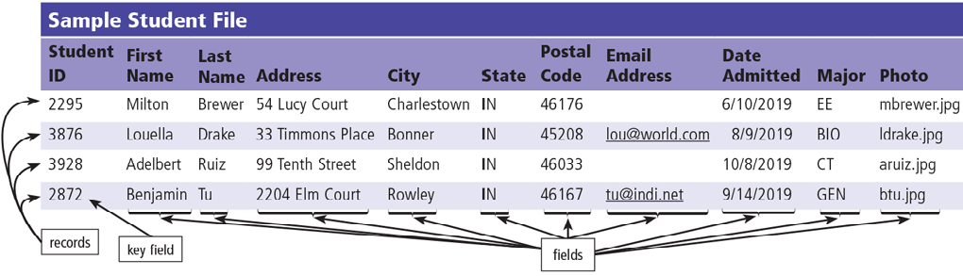
A record is a group of related fields
A primary key (主鍵) is a field that uniquely identifies each record
A foreign key (外鍵) is a field that refers to the primary key of another table, linking these two tables.
A data file is a collection of related records
Figure 11-4 This sample data file, stored on a hard drive, contains four records, each with eleven fields.
Notes:
主鍵:每一個表中只會有一個(例如student ID)，用來辨識該筆資料(如同字典，一個條目只會對應一個字)
外鍵（Foreign Key） 是資料庫中用來建立和強化兩個資料表之間關聯的一種約束。其值對應到另一個資料表中的主鍵（Primary Key），從而建立起兩個資料表之間的聯繫。
如表中的major，就有可能是一個外來鍵，連結到另一張統整了所有科系的表

Slide 12
Databases, Data, and Information (9 of 10)
File maintenance refers to the procedures that keep data current
Adding records
Modifying records
Deleting records
Notes:
檔案維護

Slide 13
Databases, Data, and Information (10 of 10)
Validation (驗證) compares data with a set of rules or values to determine if the data meets certain criteria
Alphabetic/Numeric check (確保data格式正確)
Range check (data必須在下限跟上限之間)
Consistency check (確保data具有邏輯性)
Completeness check (確保關鍵訊息不缺失)
Check digit (確保資料的準確性和完整性)
E.g. ID card number 身分證字號
Other checks
Notes:
Alphabetic/Numeric check 字母/數字 確保數據格式正確
Range check 數據必須在下限跟上限之間 例: 年紀不能是-1歲
Consistency check一致性 確保一筆紀錄的多個數據具有邏輯性 例: 訂房時，退房日期必須晚於訂房日期
Completeness check完整性 例: 不能留空

Slide 14
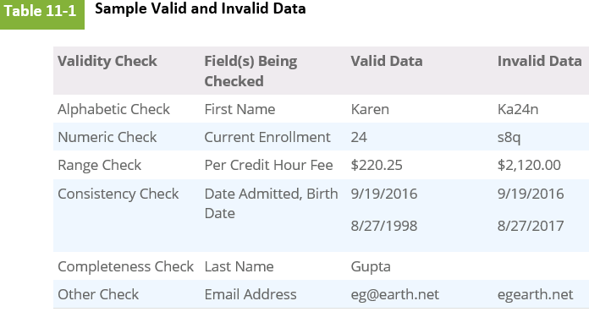

Slide 15
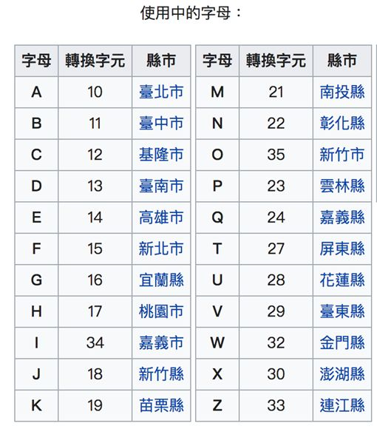
Check digit of ID card number
假設身分證字號為
1.將英文字母轉換為數字
(A=10)以此類推
將數字碼依序*8 *7…
計算總和跟10的倍數差多少
英文字母
*8
*7
*6
*5
*4
*3
*2
*1
檢查碼
數字碼1~8
X1 X2
X1*1+ X2*9
例: A12345678?
總和 = 1*1+0*9+1*8+2*7+3*6+4*5+5*4+6*3
+7*2+8*1=121
距離10的倍數(130)差9，所以 ?=9

Slide 16
https://youtube.com/shorts/ZEo9C0xPiXs?si=8E8pYya53AC-icNu
https://youtu.be/pCoey5t8B6E?si=xhGZWqm6f1o-w4Lf

Slide 17
File Processing Systems and Databases ( 1 of 6)
File processing system
Each department has its own set of files
Redundant data
Isolated data – Data Silos
Database approach
Programs and users share data
Reduced data redundancy
Improved data integrity (完整性)
Shared data
Easier access
Reduced development time
Notes:
文件處理系統是一種使用獨立文件來儲存和組織數據的方法。每個部門（如會計、庫存、人事）通常都有自己專屬的數據文件
缺點: data缺乏標準化、缺乏中央管理、數據: 相同的數據（例如客戶地址）會被儲存在多個應用程式的不同文件中，浪費儲存空間並容易造成不一致
資料孤島=每個部門的資料都是各自儲存各自定義，像一座座孤島一樣無法和企業內部的其他數據進行連接互動
使用一個集中式的系統來管理數據，將數據視為一種集中的、共享的資源，由 DBMS 進行管理，這極大地提高了數據的效率、一致性和安全性。

Slide 18
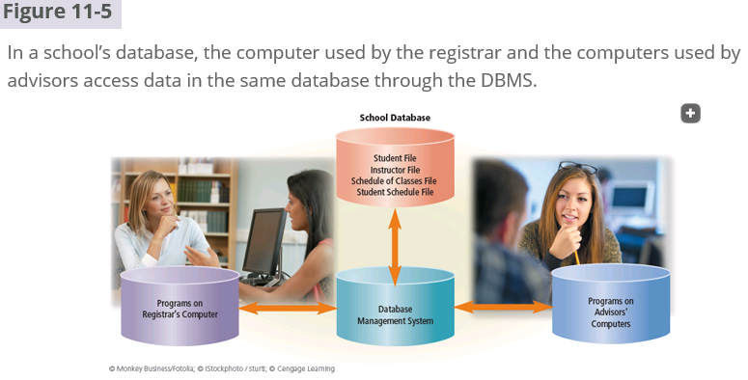
DBMS: DataBase Management System
Notes:
學校可以利用資料庫來集中管理所有的學生、教師和課程資訊。透過DBMS，不同部門的使用者可以同時存取和更新資料，確保資料的一致性和準確性。這有助於學校提高行政效率。

Slide 19
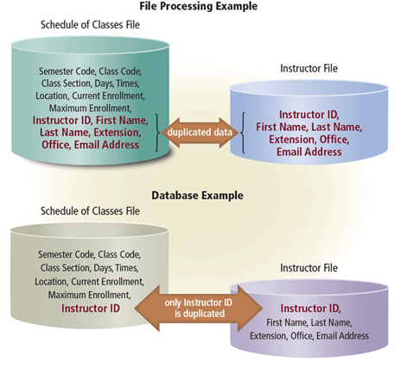
Figure 11-6 With file processing, both files contain all six instructor data fields. With a database, only the Instructor file contains the First Name, Last Name, Extension, Office, and Email Address fields. Other files, such as the Schedule of Classes file, contain only the Instructor ID — which links to the Instructor file when instructor data is needed.
Notes:
資料庫透過建立關聯，有效地減少了資料冗餘，提高了資料的一致性，並改善了資料查詢的效率。
資料庫在處理大量資料時，能夠提供更有效率、更可靠的管理方式。

Slide 20
File Processing Systems and Databases ( 3 of 6)
Disadvantages of a database approach
Can be more complex than a file processing system
Require more memory and processing power
Data can be more vulnerable
Notes:
成本較高
因為是集中管理，所以一旦安全防線被突破，所有data都會有風險
由於所有數據都集中儲存在一個地方，如果伺服器或 DBMS 軟體發生故障，所有依賴於該數據的應用程式都會停擺。這要求必須有嚴格的備份和恢復策略

Slide 21
File Processing Systems and Databases ( 4 of 6)
Web databases offer information about:
Jobs (e.g.104人力銀行)
Travel (e.g. booking.com)
Destinations
Television programming
Photos
Movies
Videos (e.g. youtube)
Local and national weather
Sporting events (e.g. espn)
Legislative information
Notes:
網頁資料庫: 它用於儲存所有與網站運作相關的動態數據，通過網頁介面提供使用者查詢
通常涵蓋使用者生活方面的資訊

Slide 22
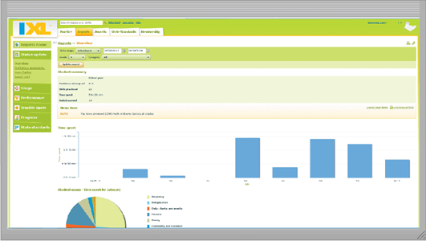
File Processing Systems and Databases ( 5 of 6)
Notes:
IXL learning題庫型學習系統，資料庫的應用例子(題庫)

Slide 23
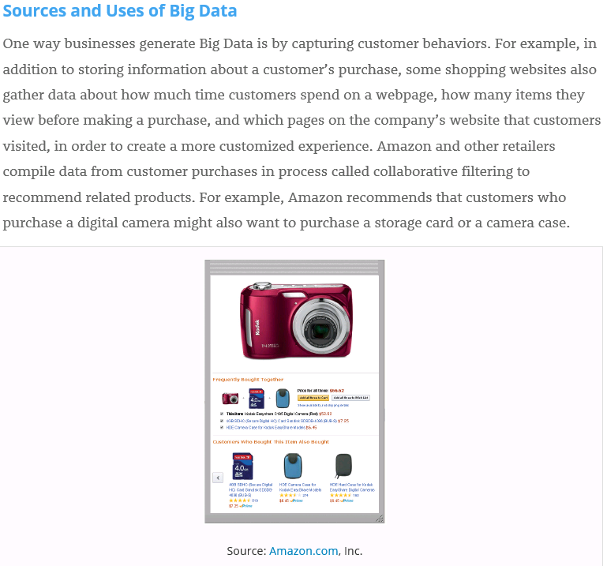
Notes:
大數據的來源與應用：以電商為例
企業透過收集顧客行為數據來產生大數據，並進一步利用這些數據來改善服務品質和提升營收。
大數據的來源：顧客行為數據
購買/瀏覽/搜尋/互動
Amazon的「您可能也會喜歡」
原理：Amazon會分析購買某一商品的用戶，同時也購買了哪些其他商品，以此作為推薦的依據。
效益：透過推薦相關商品，增加顧客的購買意願，提高銷售額。
但是可能會產生風險 就是 data creep

Slide 24
Data creep 資料蔓延
Unintentional Collection
Over-Retention
Scope Expansion
Notes:
無意識的收集 數據是在應用程式、系統或業務流程運行時，作為副產品被收集的，而非經過深思熟慮的決策。
數據保留過久 組織將舊的、不再需要的數據保留了比法律或業務規定的更長的時間。
範圍擴大 隨著時間推移，數據收集的範圍和類型逐漸超出了最初的用途。
這些會造成安全風險、消耗數據儲存/備份資源

Slide 25
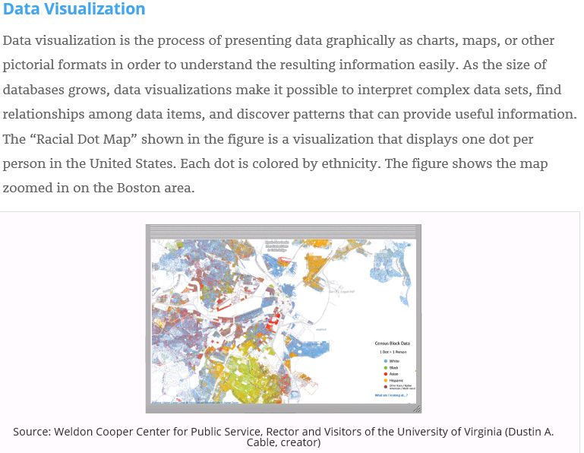
Notes:
資料視覺化
「種族點地圖」是一種應用

Slide 26
File Processing Systems and Databases (6 of 6)
A data model defines how users view the organization of the data
Relational database
Object-Oriented DataBase (OODB)
Multidimensional and other database types
Notes:
資料模型用來描述資料庫中數據的特性
關聯式模型 (Relational Model): 最主流的模型，數據以表格 (Tables) 的形式組織，使用主鍵和外鍵建立關係。這是現代 SQL 資料庫的基礎。
物件導向模型 (Object-Oriented Model): 將數據和處理數據的程序打包成物件。可以儲存各種複雜的資料型態，例如圖形、影像、聲音等

Slide 27
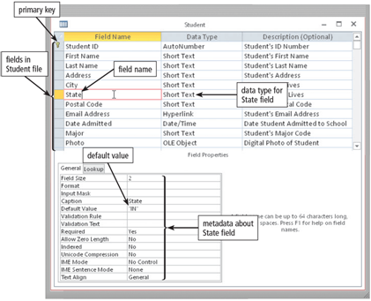
A data dictionary contains data about each file in the database and each field in those files
Figure 11-7 A sample data dictionary entry shows the fields in the Student file and the properties of the State field. Source: Microsoft
Notes:
數據字典（Data Dictionary）就像是一本詳細記錄資料庫中所有資料的「字典」。它提供了一種系統化的方法來定義、描述和管理資料庫中的數據元素。

Slide 28
Database Management Systems (2 of 10)
A DataBase Management System (DBMS) provides several tools that allow users and programs to retrieve and maintain data in the database
A query (查詢) is a request for specific data from the database.
Query language
Query by example
Form
Report writer

Slide 29
Database Management Systems (3 of 10)
A query language consists of simple, English-like statements that allow users to specify the data to display, print, store, update, or delete.
Structured Query Language (SQL) is a popular query language that allows users to manage, update, and retrieve data.

Slide 30
Database Management Systems (4 of 10)
Figure 11-8a (SQL statement SELECT CLASS_TITLE, CLASS_SECTION, MAXIMUM_ENROLLMENT - CURRENT_ENROLLMENT AS SEATS_REMAINING FROM SCHEDULE_OF_CLASSES, CLASS_CATALOG WHERE SCHEDULE_OF_CLASSES.CLASS_CODE = CLASS_CATALOG.CLASS_CODE ORDER BY CLASS_
Select From 從...選
Where 篩選
Order 排序
Notes:
計算最大報名人數減去目前已報名人數，並將結果以別名 SEATS_REMAINING 表示，代表剩餘的座位數。
查詢條件是兩個表格中的CLASS_CODE必須相同，以確保資料的一致性。最後，根據CLASS進行排序。

Slide 31
Database Management Systems (5 of 10)
Figure 11-8b (SQL statement results)
Class Title | Class Section | Seats Remaining
Algebra | 51 | 14
Art Appreciation | 52 | 19
English Composition 1 | 02 | 5
Introduction to Sociology | 01 | 14
Figure 11-8 A sample SQL statement and its results. Notice that the query results show meaningful column headings instead of the actual SQL field names. Source: Microsoft

Slide 32
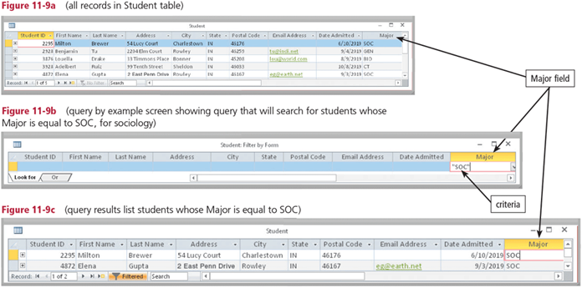
Most DBMSs include Query By Example (QBE), a feature that has a graphical user interface to assist users with retrieving data
Figure 11-9 Shown here is a Microsoft Access QBE, which searches for students whose major is sociology. Source: Microsoft
Notes:
QBE為了方便使用者使用，會有圖形化使用者介面，對非專業用戶很友好

Slide 33
Database Management Systems (7 of 10)
A form is a window on the screen that provides areas for entering or modifying data in a database.
A report writer allows users to design a report on the screen, retrieve data into the report design, and then display or print the report.
Notes:
表單是一個顯示在螢幕上的視窗，用來輸入/修改資料庫中的資料
報表生成器能讓用戶設計報表，並將資料提取到報表中，這樣就不需要使用較複雜的SQL語言

Slide 34
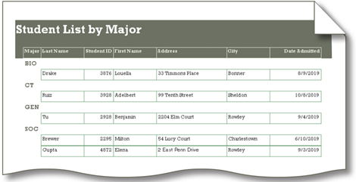
Figure 11-10 This report, created in Microsoft Access, displays student information by major. Source: Microsoft
Notes:
報表的範例

Slide 35
Database Management Systems (9 of 10)
A DBMS provides means to ensure that only authorized users access data
Access privileges
Principle of least privilege policy
“least privilege policy”(最小權限原則)
舉個例子：
你想吃零食，就只去零食櫃，拿你想要的零食。
你想換衣服，就只去衣櫃，拿你需要的衣服。
你不會隨便打開工具箱，因為你可能不知道怎麼用那些工具。
讓每個使用者或程式，只擁有完成它該做的事情所需要的權限。
Notes:
Access privileges
存取權限
存取權限就是決定誰能做什麼、不能做什麼的規則。
最小權限原則
賦予每一個合法動作最小的權限，就是為了保護數據以及功能避免受到錯誤或者惡意行為的破壞
安全： 壞人就比較難入侵你的系統，因為他們拿到的權限很少。
穩定： 因為大家只做自己該做的事，系統就不容易出錯。
給別人或程式剛剛好的權限，不要給太多。
這樣可以讓系統更安全、更穩定。

Slide 36
Database Management Systems (10 of 10)
A DMBS provides a variety of techniques to restore the database to a usable form in case it is damaged or destroyed
Backup
Log
Recovery utility
Continuous backup
Notes:
Log 日誌
Recovery utility 恢復工具
持續備份與一般每日，每周的定期備份是不一樣的，持續備份能夠捕捉到所有的數據變更，當發生任何更改時，這些變更會被立即記錄和備份。通常會仰賴日誌紀錄(log)

Slide 37
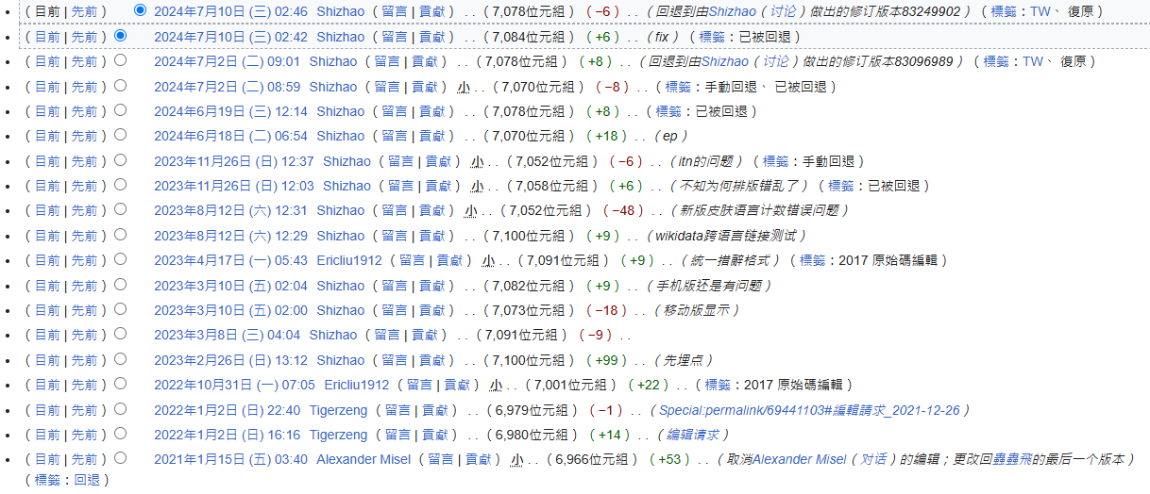
Wiki Log
Notes:
log範例

Slide 38
https://youtu.be/7okXAW8MwAc?si=4GDZLzX4rMBC4PEO

Slide 39
System Development (1 of 24)
An information system is a collection of hardware, software, data, people, and procedures that work together to produce information
System development is a set of activities used to build an information system

Slide 40
System Development (2 of 24)
System development is a set of activities used to build an information system
System development activities are grouped into phases, and is called the System Development Life Cycle (SDLC)
Notes:
系統開發生命週期

Slide 41
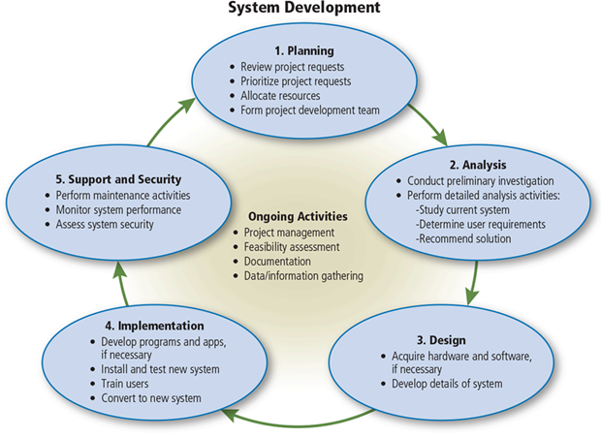
Figure 11-11 System development often consists of five phases that form a loop. Several ongoing activities also take place throughout system development.

Slide 42
System Development (4 of 24)
System development should follow three general guidelines:
Group activities into phases
Involve users
Define standards
Notes:
系統開發指引
分階段進行
讓使用者參與開發
設定標準 確保一致性

Slide 43
System Development (5 of 24)
System development should involve representatives from each department in which the proposed system will be used
A systems analyst is responsible for designing and developing an information system
Notes:
在系統開發的各個階段，都應該邀請那些將直接使用或受到系統影響的部門代表參與進來
因為使用者最能知道他們需要的是甚麼
系統分析師，負責將複雜的業務需求設計可行的資訊系統

Slide 44
System Development (6 of 24)
Project management is the process of planning, scheduling, and then controlling the activities during system development (任務:協調、管理、最大化效率)
To plan and schedule a project efficiently, the project leader identifies the following elements:
Scope
Required activities
Time estimates for each activity
Cost estimates for each activity
Order of activities
Activities that can take place at the same time
Notes:
PM(專案經理) 是專案的核心管理者，負責協調資源，管理團隊
範圍 (Scope)：
專案的目標是什麼？
要交付哪些產品或服務？
專案的界線在哪裡？
所需活動 (Required activities)：
完成專案需要哪些具體的工作任務？
每個任務的詳細內容是什麼？
各項活動的時間估算 (Time estimates for each activity)：
完成每項任務需要多少時間？
考慮到各種不確定因素，預留一些緩衝時間。
各項活動的成本估算 (Cost estimates for each activity)：
完成每項任務需要多少成本？
包括人力、物力、時間等各方面的成本。
活動順序 (Order of activities)：
各項任務之間的先後順序是什麼？
哪些任務必須在其他任務之前完成？
同時進行的活動 (Activities that can take place at the same time)：
哪些任務可以同時進行？
找出可以並行執行的任務，以縮短專案總時程。

Slide 45
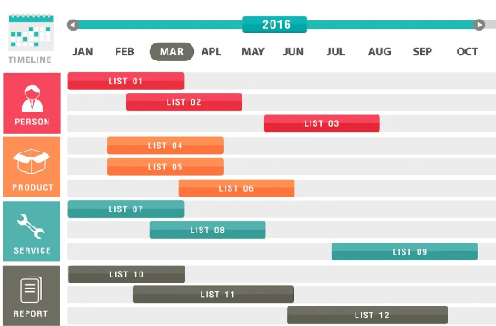
Gantt & PERT charts
Gantt chart
視覺化專案管理
方便追蹤進度
X軸 : 時間尺度 (e.g. 年、月)
條狀圖 : 長度表示持續時間
左側欄位 : 任務列表
Notes:
有兩種圖常被用來計畫或管理
甘特圖-以時間當主軸，主要顯示專案中各項任務開始和結束時間，強調的是時間和任務的持續時間，透過長條展是每任務的進展
Ntu cool就有類似的圖

Slide 46
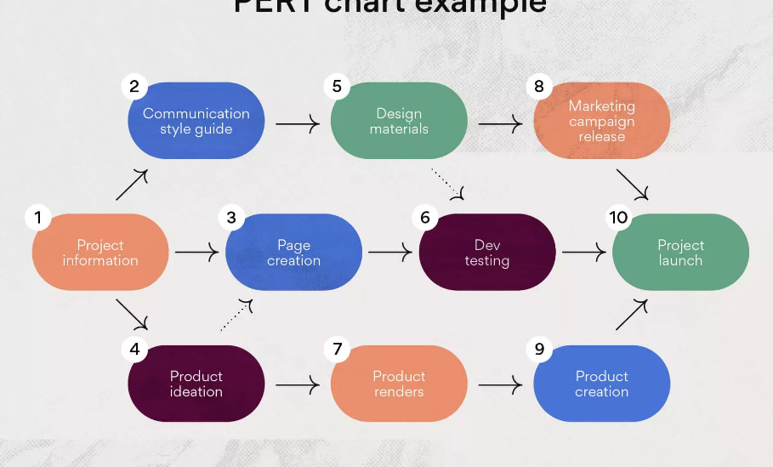
Gantt & PERT charts
PERT chart
顯示各任務的依賴關係
用來估計時間&風險評估
Notes:
有兩種圖常被用來計畫或管理
PERT圖(計畫評核術)-主要顯示的是專案中各任務之間的依賴關係和完成每個任務所需的時間

Slide 47
System Development (8 of 24)
Feasibility (可行性) is a measure of how suitable the development of a system will be to the organization
Operational feasibility
Schedule feasibility
Technical feasibility
Economic feasibility
Notes:
可行性評估
在投入大量資源之前，評估專案的可行性，可以降低失敗的風險
營運可行性 (Operational Feasibility)能不能賺錢
時程可行性 (Schedule Feasibility)時間夠不夠
經濟可行性 (Economic Feasibility)錢夠不夠
技術可行性 (Technical Feasibility)掌握的技術能不能做到這些事

Slide 48
System Development (9 of 24)
Documentation is the collection and summarization of data, information, and deliverables
Maintaining up-to-date documentation should be an ongoing part of system development
像是一本使用者手冊
Notes:
文件它記錄了系統「是什麼」以及「如何運作」，就像使用者手冊
當需求或程式碼發生變化時，相關文件必須即時更新，讓未來的維護人員能夠快速定位和修復錯誤

Slide 49
System Development (10 of 24)
During system development, members of the project team gather data and information
Review documentation
Observe
Survey
Interview
Joint-Application Design (JAD) Sessions
Research
Notes:
理解現有系統、確定業務需求有一些資料與資訊收集方法
讓使用者、系統分析師和IT 專家在一個結構化的會議環境中共同工作，以快速定義需求和設計系統。

Slide 50

Figure 11-13 During a JAD session, the systems analyst is the moderator, or leader of the discussion. Another member, called the scribe, records facts and action items assigned during the session.

Slide 51
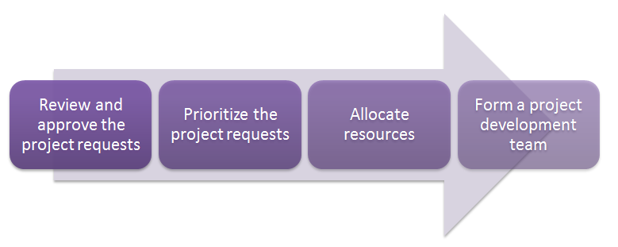
System Development (12 of 24)
The planning phase for a project begins when the steering committee receives a project request
Four major activities are performed:
Notes:
規劃階段 (Planning Phase)：
審核專案需求： 了解客戶或組織對新系統的需求。
優先排序： 根據需求的重要性，決定開發的優先順序。
分配資源： 配置人力、財務等資源。
組建團隊： 組成專案開發團隊。

Slide 52
System Development (13 of 24)
The analysis phase consists of two major activities:
Conduct a preliminary investigation (初步調查)
Determines the exact nature of the problem or improvement
Interview the user who submitted the request
Perform detailed analysis (詳細分析)
Study how the current system works
Determine the users’ wants, needs, and requirements
Recommend a solution
Notes:
分析階段 (Analysis Phase)：
初步調查： 對現有的系統進行初步的調查和分析。 並跟需要這個系統的使用者討論要求
詳細分析： 深入研究現有系統，了解其優缺點。
使用者需求： 確定使用者對新系統的需求。
建議解決方案： 基於分析結果，提出解決方案。

Slide 53
System Development (14 of 24)
The system proposal assesses the feasibility of each alternative solution
The steering committee discusses the system proposal and decides which alternative to pursue
Modify existing system
Buy retail software
Use web apps
Build custom software
Outsource
Notes:
會討論該用哪種方式達成目標
更改已存在的系統
買軟體
建構客製化軟體
外包

Slide 54
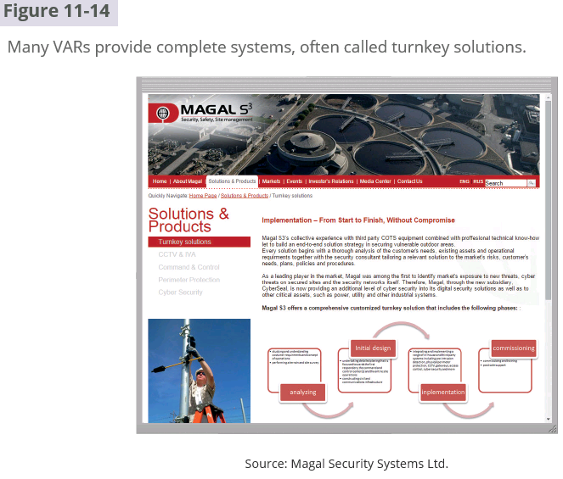
VAR: Value-Added Reseller
Notes:
開箱即用方案
廠商提供一套客戶只需要「接手」就可以直接使用，就像開箱子就能使用一樣。

Slide 55
System Development (15 of 24)
The design phase consists of two major activities
Acquire hardware and software
Develop all of the details of the new or modified information system
Notes:
獲取硬體和軟體
開發新的或修改後的資訊系統的所有細節

Slide 56
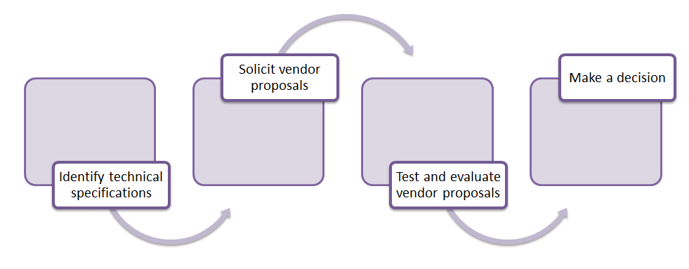
System Development (16 of 24)
To acquire the necessary hardware and software:
Identify technical specifications
Solicit vendor proposals
Test and evaluate vendor proposals
Make a decision
Notes:
採購流程
首先根據設計需求確定需要的技術細節（規格）
然後向市場上的供應商詢價和徵求解決方案
接著對這些方案進行評比
最後做出購買決策

Slide 57
System Development (17 of 24)
The next step is to develop detailed design specifications
Database design
Input and output design
Program design

Slide 58
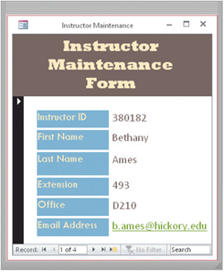
Systems analysts typically develop two types of designs for each input and output
Mock-up
Figure 11-15 Users provide their approval on inputs and outputs. This input screen is a mock-up (containing actual sample data) for users to review. Source: Microsoft
Notes:
mockup： 製作一個高擬真的網頁介面，讓使用者可以直觀地看到網頁的樣貌。

Slide 59
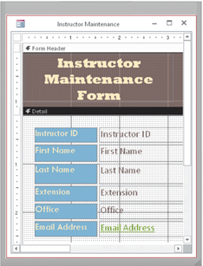
Layout chart
Figure 11-16 Shown here is a technical view in Access of the mock-up in Figure 11-15. Source: Microsoft
Notes:
layout： 決定網頁上的各個元素（如標題、圖片、按鈕）如何排列。

Slide 60
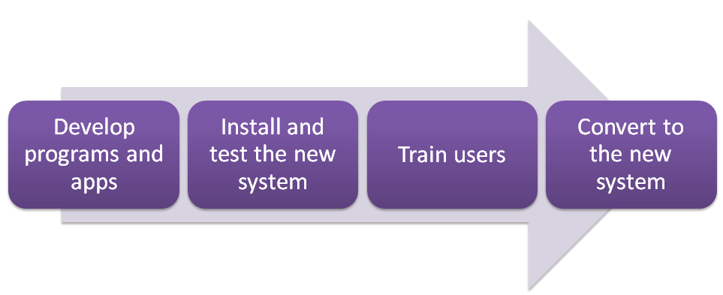
System Development (20 of 24)
A prototype (proof of concept) is a working model of the proposed system’s essential functionality
The purpose of the implementation phase is to construct the new or modified system and then deliver it to users
Notes:
開發到現在，我們已經有了一個系統的雛形，讓我們可以提前體驗和評估這個系統
以我們土木系來比喻，就像蓋房子先看模型一樣，可能功能不完整，但可以讓我們看到這個系統的基礎功能是否可行，以及使用者介面大致的樣子。
實施階段 (Implementation Phase)：
開發程式： 根據設計，編寫程式碼。
安裝測試： 將系統安裝到硬體上，並進行測試。
使用者培訓： 對使用者進行系統操作的培訓。
系統轉換： 將舊系統的資料遷移到新系統。

Slide 61
System Development (21 of 24)
Various tests should be performed on the new system
Unit test
Verifies that each individual program or object works by itself
Systems test
Verifies that all programs in an application work together properly
Integration test
Verifies that an application works with other applications
Acceptance test
Checks the new system to ensure that it works with actual data
Notes:
測試由小到大，就像寫程式debug的時候會先從一小部分來看。開發系統也是先單元測試
都沒問題了後再整合測試
最後驗收

Slide 62

System Development (22 of 24)
Training involves showing users exactly how they will use the new hardware and software in the system
One-on-one sessions
Classroom-style lectures
Web-based training
Figure 11-17 Organizations must ensure that users are trained properly on the new system. One training method uses hands-on classes to learn the new system.
Notes:
使用者接觸到新軟體一定不熟悉，所以我們會需要訓練使用者使用新系統
一對一
教室式
網路

Slide 63
System Development (23 of 24)
One or more of four conversion strategies can be used to change from the old system to the new system
Direct conversion
Parallel conversion
Phased conversion
Pilot conversion
Notes:
直接轉換
平行轉換 新舊同時運行
分階段轉換 一段一段轉
先導轉換 小部門測試

Slide 64
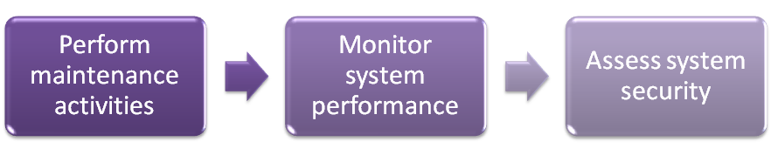
System Development (24 of 24)
The purpose of the support and security phase is to provide ongoing assistance for an information system and its users after the system is implemented
Notes:
維護階段 (Maintenance Phase)：
系統維護： 定期對系統進行維護，修復錯誤。
效能監控： 監控系統的運行狀況，確保系統的穩定性。
安全評估： 評估系統的安全性，防止資料洩露。

Slide 65
https://youtu.be/okZShKgXdL8?si=-X5Um0GcWbWQyMq8

Slide 66
Application Development Languages and Tools (1 of 17)
A programming language is a set of words, abbreviations, and symbols that enable a software developer to communicate instructions to a computer or mobile device
An application development tool provides a means for creating, designing, editing, testing, and distributing programs and apps
Notes:
程式語言簡單來說，就是一組由字詞、符號和語法規則所組成的集合，用來讓開發者向電腦下達指令，讓電腦執行特定的任務。
應用程式開發工具 整合開發環境，提高程式設計的效率

Slide 67
Application Development Languages and Tools (2 of 17)
With a procedural language, the programmer writes instructions using English-like words that tell the computer what to accomplish and how to do it
Notes:
程序性語言，算是現在java、c++的祖先

Slide 68
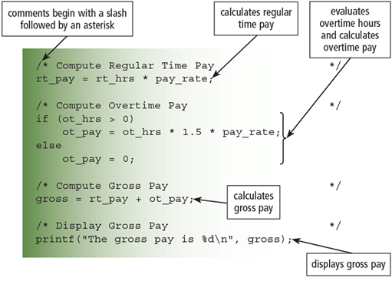
The C programming language is used to write many of today’s programs
Figure 11-18 An excerpt from a C payroll program. The code shows the computations for regular time pay, overtime pay, and gross pay; the decision to evaluate the overtime hours; and the output of the gross pay.

Slide 69
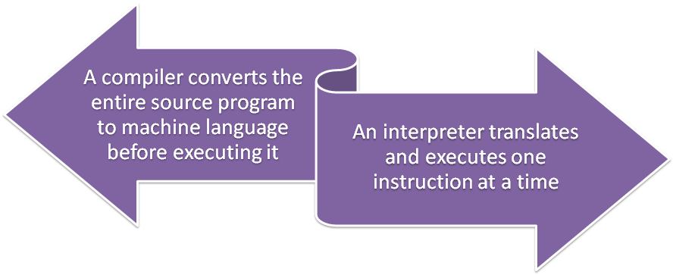
A compiler converts the entire source program to machine language before executing it.
An interpreter translates and executes one instruction at a time.

Slide 70
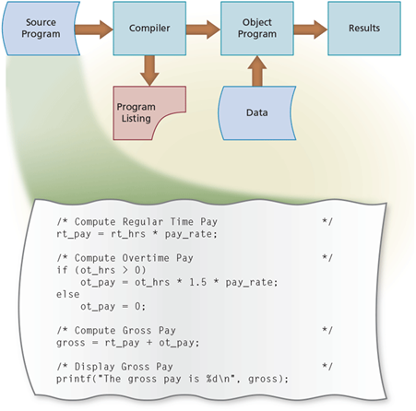
Compiler 編譯器
在執行前會將整個原始程式轉換為機器語言
產生獨立的可執行檔
執行速度快
除錯（Debug）過程可能較慢
Figure 11-19 A compiler converts the source program (C, in this example) into a machine language object program.
Notes:
像是C++。編寫後會要編譯，不能直接執行，編譯完後會有一個.exe的檔案

Slide 71
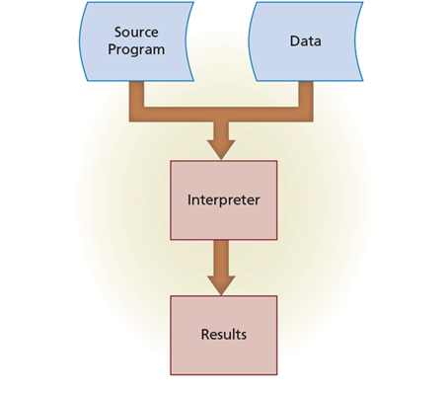
Interpreter 直譯器
一次翻譯並執行一條指令
邊翻譯邊執行
執行速度較慢
啟動和除錯較為靈活
(因為是單步執行)
Figure 11-20 With an interpreter, one instruction of the source program at a time is converted into machine language and then immediately executed by the computer or mobile device.
Notes:
像是Python編寫完後就能直接執行了，而且也不會多一個檔案

Slide 72
Application Development Languages and Tools (7 of 17)
An Object-Oriented Programming (OOP) language allows system developers to implement objects in a program
Other advantages include:
Objects can be reused
Developers create applications faster
Most object-oriented application development tools are Integrated Development Environments (IDEs)
Notes:
OOP（如 Java, Python, C#）強調將資料與處理資料的方法封裝成物件。
物件可以被重用
開發人員能更快地建立應用程式
大多數物件導向的應用程式開發工具都是整合開發環境

Slide 73
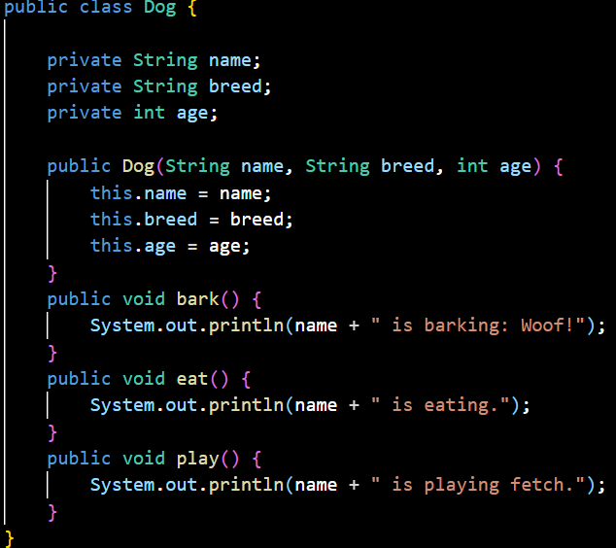
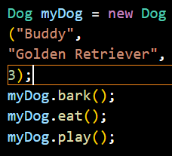
Figure 11-21 A portion of a Java program and the window the program displays.
Notes:
這是java的一個class的例子
我設計了一個狗的class
屬性有名字、品種、年齡
當要使用的時候就需要構建一個新的物件，這個物件的類別是狗，那麼這個物件就可以用這個類別裡面定義的方法
像這裡我宣告了一個物件是myDog，他的名字是Buddy，品種是黃金獵犬，歲數3
那我在宣告後就能用bark，eat，play這三個已經宣告了的方法

Slide 74
Application Development Languages and Tools (9 of 17)
C++ is an extension of the C programming language
Additional features for working with objects
Visual Studio is Microsoft’s suite of object-oriented application development tools that assists software developers in building programs and apps for Windows or any operating system that supports the Microsoft .NET Framework
Notes:
C++ 是一種強大的語言，它在 C 語言的基礎上引入了**物件導向程式設計（OOP）**功能
Visual Studio 是微軟的一套物件導向應用程式開發工具，協助軟體開發人員建構適用於 Windows 或任何支援 Microsoft .NET Framework 的作業系統的程式和應用程式

Slide 75
Application Development Languages and Tools (10 of 17)
A 4GL (Fourth-Generation Language) is a nonprocedural language that enables users and software developers to access data in a database
One popular 4GL is SQL (Structured Query Language)
Notes:
4GL 第四代語言 非程序化語言 更接近人類

Slide 76
Application Development Languages and Tools (11 of 17)
Classic programming languages include:
BASIC: Beginner's All-Purpose Symbolic Instruction Code
COBOL: COmmon Business-Oriented Language
FORTRAN: Formula Translation
RPG: Report Program Generator
COBOL 和 FORTRAN 仍在企業中佔有一席之地，因為它已穩定運行很長一段時間，將這些系統完全替換或現代化的成本和風險非常高，所以漸進式升級比完全替換更具效益。
Notes:
經典程式語言包括：
BASIC：初學者通用符號指令碼
COBOL：通用商業導向語言
FORTRAN：公式翻譯
RPG：報告程式生成器
COBOL 和 FORTRAN 仍在企業中佔有一席之地，因為它已穩定運行很長一段時間，將這些系統完全替換或現代化的成本和風險非常高，漸進式升級比完全替換更具成本效益。

Slide 77
Application Development Languages and Tools (12 of 17)
An application generator is a program that creates source code or machine code from a specification of the required functionality
Often bundled as part of a DBMS
A macro (巨集) is a series of statements that instructs a program or app how to complete a task
You usually create the macro in one of two ways:
Record the macro
Write the macro
Notes:
應用程式產生器： 開發者只需定義「要什麼 (What to do)」而不是「如何做 (How to do it)」，電腦就會自動產生程式碼
巨集：一系列指令的集合，用於告訴程式或應用程式如何完成一個特定的任務。
是一種自動化工具，用於將重複性的操作步驟（如在 Excel 中格式化報表）錄製或編寫成單一指令，提高使用者和開發者的效率。

Slide 78
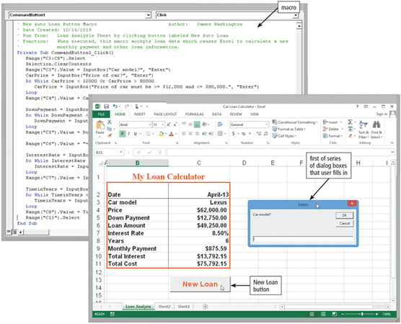
Figure 11-22 The top screen shows a macro used to automate an auto loan. After this macro is written, the user taps or clicks the New Loan button to run the macro. The bottom screen shows the macro guiding the user through part of the data entry process. Source: Microsoft
Notes:
這頁就是Excel的巨集的應用

Slide 79
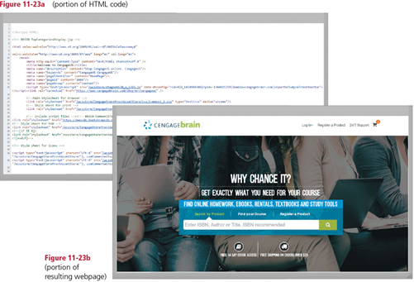
Hyper-Text Markup Language (HTML) is a special formatting language that software developers use to format documents for display on the web.
Figure 11-23 The portion of the HTML code in Figure 11-23a generates a portion of the Cengage Learning CengageBrain
Notes:
超文本標記語言（HTML）是一種特殊的格式化語言，軟體開發人員用來格式化文件以在網路上顯示，是所有網頁的結構基礎

Slide 80
Application Development Languages and Tools (15 of 17)
eXtensible Markup Language (XML) allows web developers to create tags that describe the structure of information
Wireless Markup Language (WML) is a subset of XML and is used to design pages specifically for microbrowsers
Notes:
可擴展標記語言
跟HTML 不同，XML 允許開發者根據自己的需求自定義標籤，來描述資料的結構和內容。所以他是可拓展
無線標記語言
設計適合在小型螢幕設備（如手機）上顯示的網頁

Slide 81
Application Development Languages and Tools (16 of 17)
To add interactivity on webpages and to add special media effects, such as animated graphics, scrolling messages, calendars, and advertisements, web developers write small programs called scripts using a variety of scripting languages
JavaScript
Perl
PHP: Personal Home Page
Python
Ruby
Notes:
為了在網頁上添加互動性和特殊媒體效果，例如動畫圖形、滾動消息、廣告，網頁開發人員使用各種腳本語言編寫稱為腳本的小型程式。
JS
一種用於創建互動式網頁的程式語言。它可以在瀏覽器中直接執行，讓網頁動起來。

Slide 82
Compare
Quick development, strong user experience: JavaScript, Ruby
System administration, text processing: Perl, Python
Content management: PHP
Data science, machine learning: Python
Multi-purpose, versatile: Python
Notes:
快速開發、重視使用者體驗： JavaScript、Ruby
系統管理、文字處理： Perl、Python
後端開發、CMS： PHP
資料科學、機器學習： Python
多功能、靈活： Python

Slide 83
https://youtu.be/ziO-RZJIQXU?si=qtl2os315Ntq3wI1
https://youtu.be/1ohc8pO-low?si=NiDv_BK-DX-lorfd
https://youtu.be/HFHVkjsdH9w?si=eIf9nW3IRZzaFyn4

Slide 84
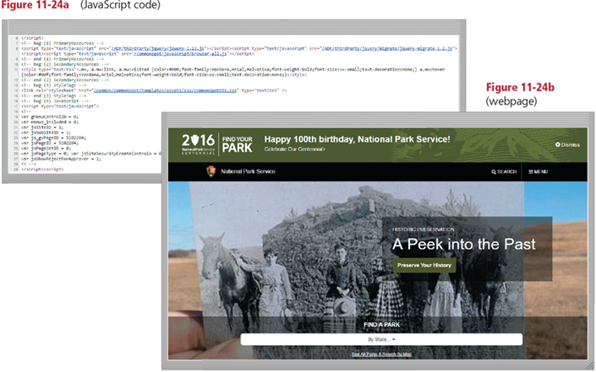
Figure 11-24 Shown here is a portion of the JavaScript code and its associated National Park Service webpage. Source: National Park Service, United States (U.S.) Department of the Interior.
Notes:
JS的應用

Slide 85
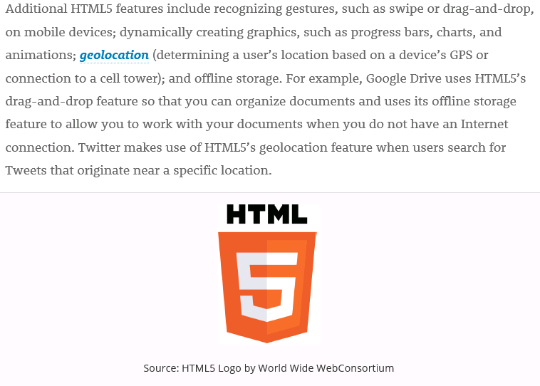
HTML: Hyper-Text Markup Language
GPS: Global Positioning System
Notes:
這張圖片主要在介紹 HTML5 的一些新功能。HTML5 是 HTML 的最新版本，相比之前的版本，它加入了很多新的標籤和屬性，讓網頁開發者能夠創造出更豐富、更互動的網頁。
像是Google Drive： 利用 HTML5 的拖曳功能，讓使用者可以方便地整理文件；同時，透過離線儲存，即使沒有網路，使用者也能繼續編輯文件。

Slide 86
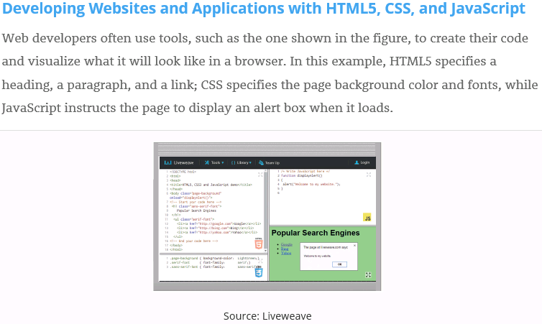
HTML: Hyper-Text Markup Language
CSS: Cascading Style Sheet
Notes:
這張圖片主要在介紹如何使用HTML CSS JavaScript建立網頁。透過 HTML 定義結構、CSS 美化樣式、JavaScript 添加互動功能，開發者可以創造出各式各樣的網頁應用程式。

Slide 87
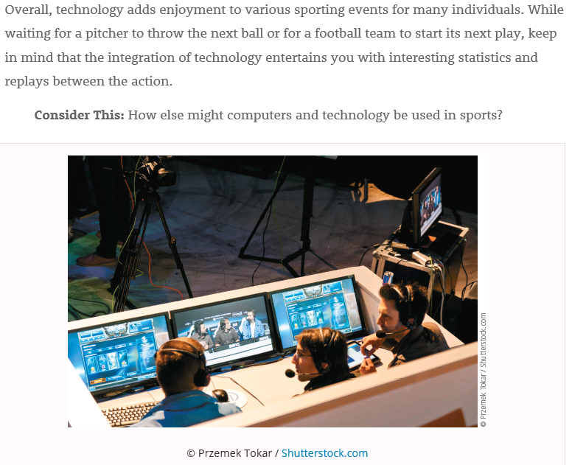
Notes:
科技與體育的結合，豐富了我們的觀賽體驗。隨著科技的不斷進步，未來會變得更精彩

Slide 88
Summary
Hierarchy of data, ways to validate data
File processing approach
DBMS
System development phases and the guidelines
Various programming languages and application development tools
Variety of web development tools
Notes:
Hierarchy of data 資料層面 結構(層級

Slide 89
Project due Dec. 29 2025
Use Access to input a list of three friends including name, email address, phone number, home address, birthday.
Design a Christmas card.
Use Access to send the Christmas card via email to each friend.
Use Access and mail merge to print Christmas card and envelop to each friend.

